Slide 1
GNR 602 Project
PROBLEM STATEMENT
Classify a satellite image using SVM classifier with a number of classes > 2 and compare the results of one versus one and one versus rest methods.
Cherish Jain (22b3937)
Harsh Anand (22b1249)
Medhansh Sharma (22b1287)

Slide 2
Dataset & its preparation
  Dataset used: DeepSat-SAT-4
  Contains 99,999 satellite image patches of size 28×28 pixels with 4 spectral bands: Red, Green, Blue, and Near-Infrared (NIR).
  Each image is labeled into one of four land cover classes: Barren Land, Trees, Grassland, or Other.
  Extracted only RGB channels (3 bands) for visualization and feature extraction; NIR retained for extended processing.

Slide 3
Feature Extraction for Satellite Image Classification
1. HOG (Histogram of Oriented Gradients)
  Captures edge and shape information by computing gradient orientations
  Parameters: 9 orientations, 8×8 pixel cells, 2×2 block size
2. LBP (Local Binary Pattern)
  Captures texture by encoding local intensity patterns
  Uses uniform patterns with 8 sampling points, radius 1
  Represented as a 59-bin normalized histogram
3. Color Histogram (HSV Space)
  Captures color distribution using histograms from Hue, Saturation, and Value channels
  16 bins per channel → 48-dimensional color descriptor
4. Gabor Filters
  Captures multi-scale, multi-orientation texture features
  Applied with 4 orientations and 2 wavelengths → 8 filter responses

Slide 4
Training Dataset preparation
Combined Feature Vector Construction
  Final per-image vector: HOG + LBP + Color Histogram + Gabor → [HOG_dim + 59 + 48 + 8]
  All features concatenated into a single matrix
2. Feature Normalization
  Applied MinMaxScaler to scale features to range [0, 1]
3. GPU Optimization
  Converted features and labels to CuPy arrays for compatibility with RAPIDS cuML
4. Train-Test Split
  Used cuml.model_selection.train_test_split with an 80-20 split
5. Label Conversion
  Labels converted from one-hot vectors to integer class labels (0 to 3)

Slide 5
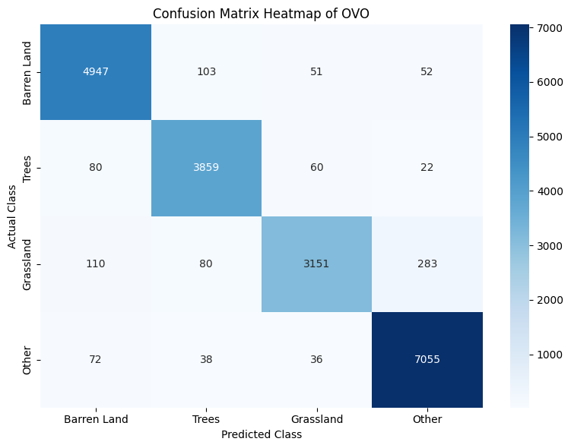
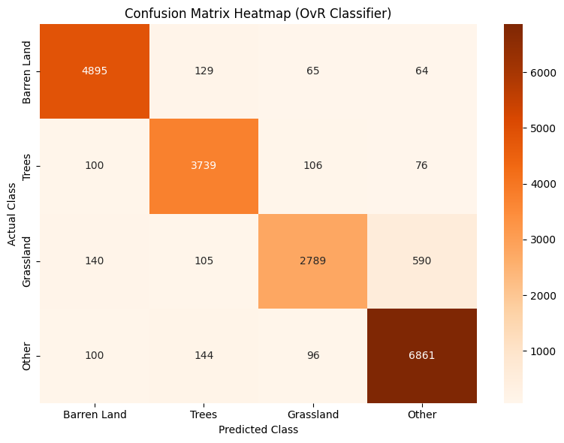
Training Results
Parameter | One-vs-One (OVO) | One-vs-Rest (OVR)
Accuracy on Test Dataset | 95.08 % | 90.17 %
Time taken for training | 797.8553941249847 s | 10.806057929992676 s

Slide 6
Patch-Based Segmentation Strategy
Patching: The input image is divided into overlapping patches of size 28×28 pixels.
Stride: The stride (e.g., 14 pixels) controls overlap—smaller stride = more detail. (Stride can be change in our UI)
Scaling: Output class maps (OvO & OvR) are resized back to original image dimensions using nearest-neighbor interpolation.
Output: Generates pixel-aligned class masks, visualizing predicted land types for each region.

Slide 7
Results

Slide 8
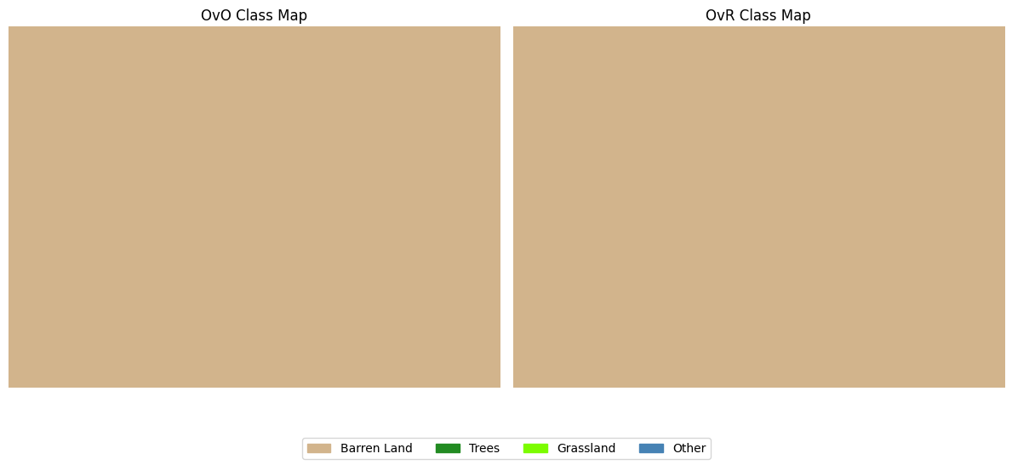
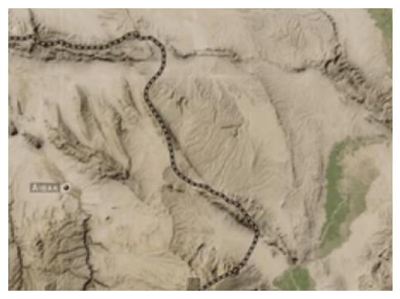
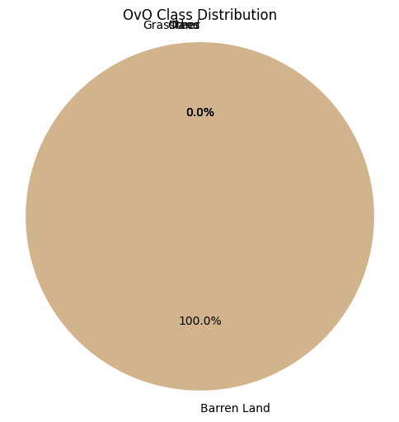

Total time for OvO predictions: 5.0558 seconds
Total time for OvR predictions: 0.2383 seconds
Avg time per OvO prediction: 0.0137 seconds
Avg time per OvR prediction: 0.0006 seconds

Slide 9
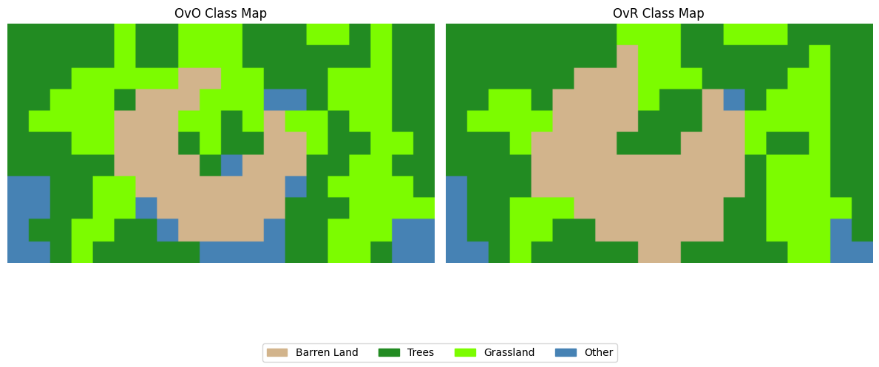
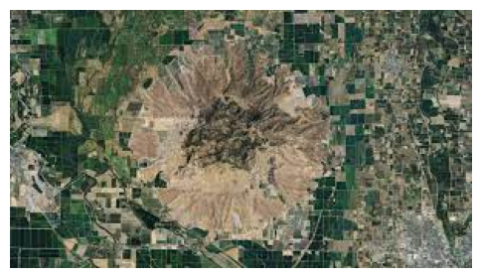
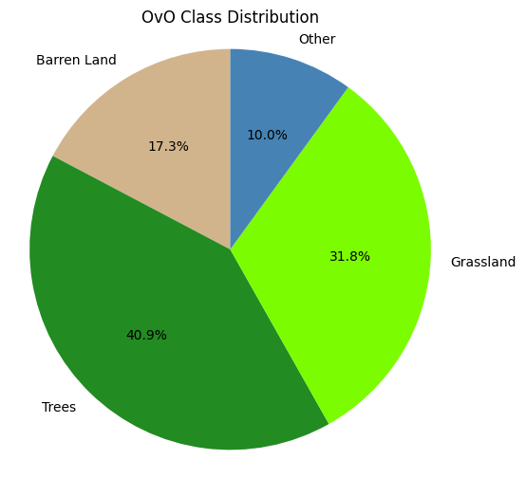
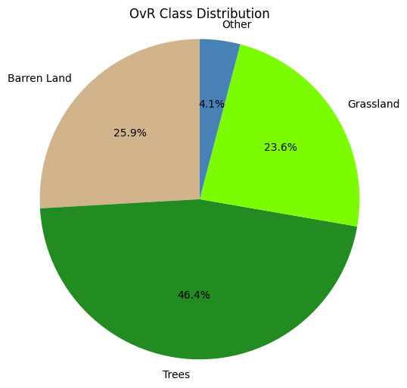
Total time for OvO predictions: 3.0243 seconds
Total time for OvR predictions: 0.1383 seconds Avg time per OvO prediction: 0.0137 seconds Avg time per OvR prediction: 0.0006 seconds

Slide 10
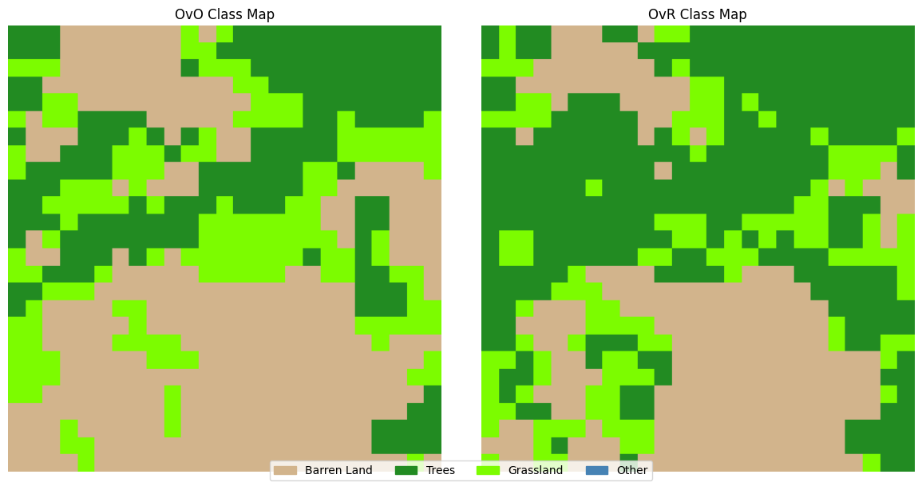
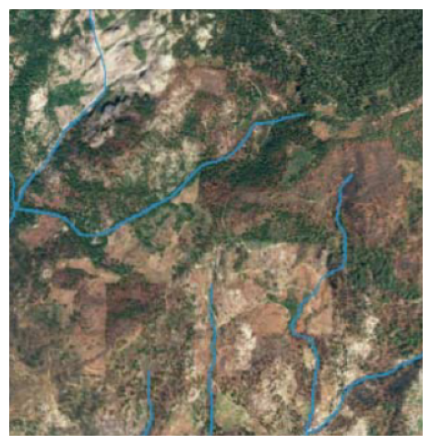
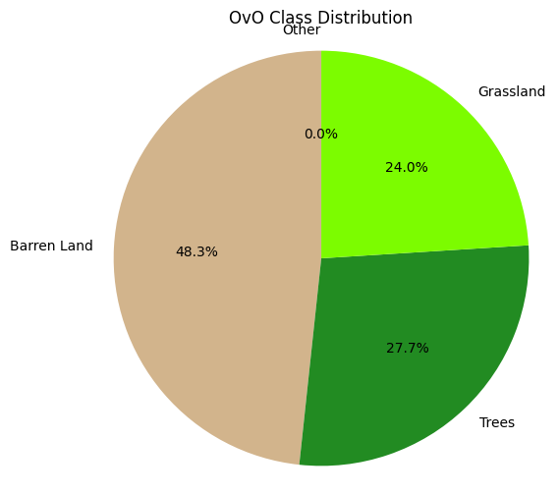
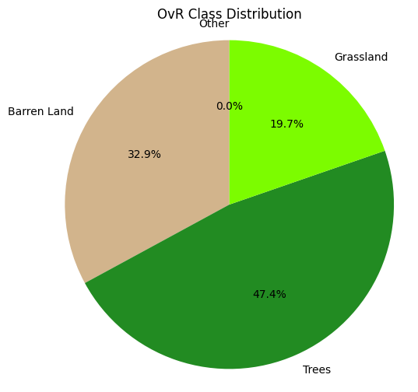
Total time for OvO predictions: 9.4590 seconds Total time for OvR predictions: 0.4397 seconds Avg time per OvO prediction: 0.0146 seconds
Avg time per OvR prediction: 0.0007 seconds

Slide 11
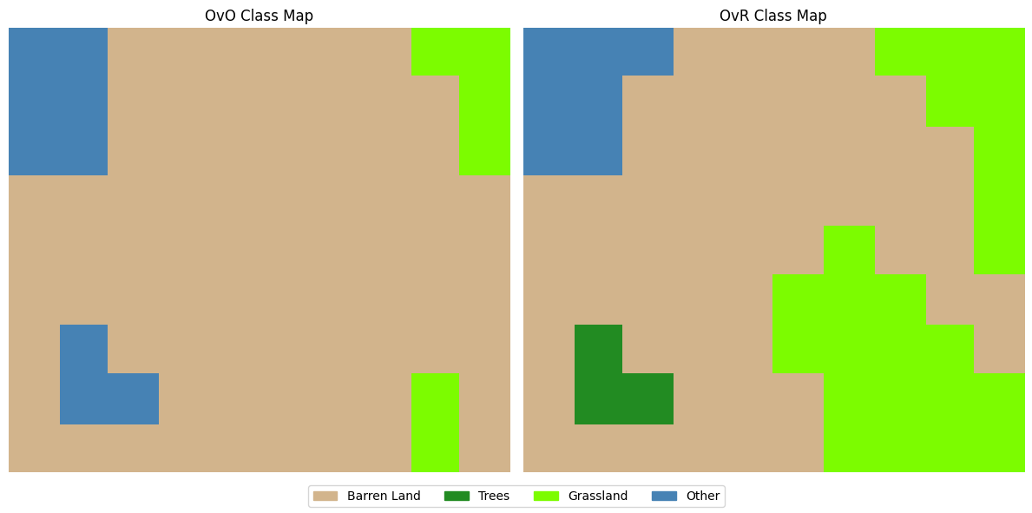
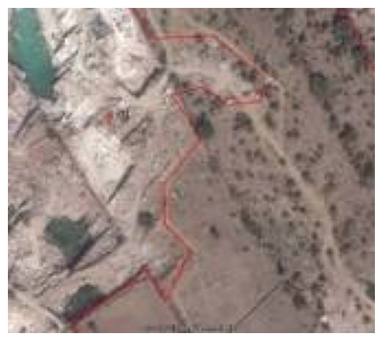
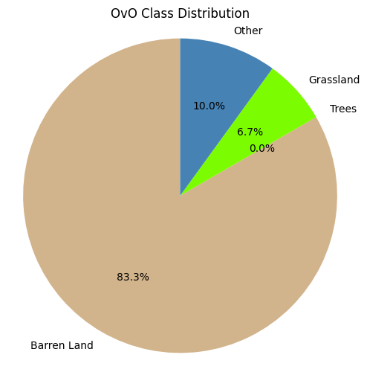
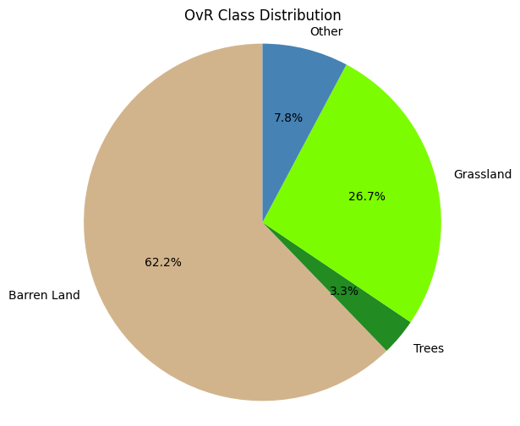
Total time for OvO predictions: 1.3001 seconds
Total time for OvR predictions: 0.0607 seconds
Avg time per OvO prediction: 0.0144 seconds
Avg time per OvR prediction: 0.0007 seconds

Slide 12
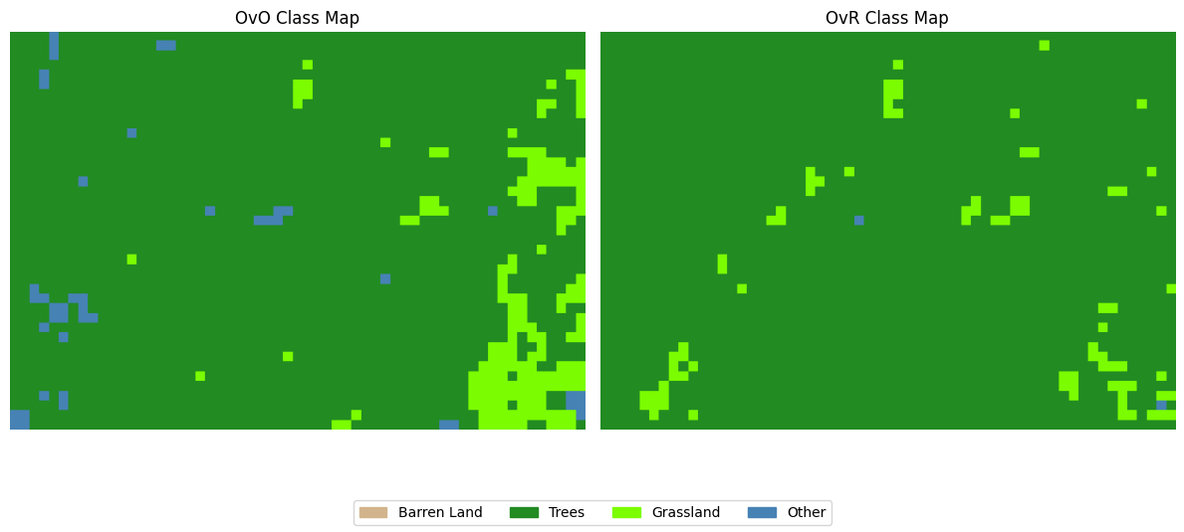
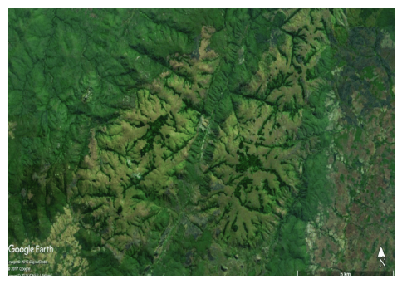
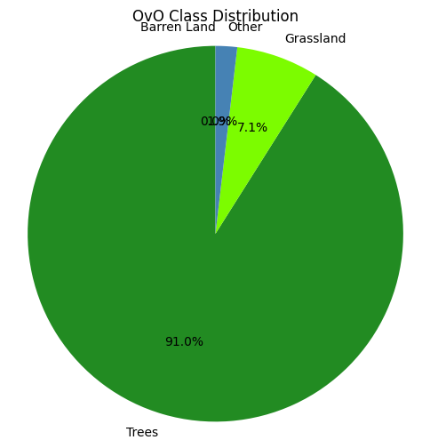
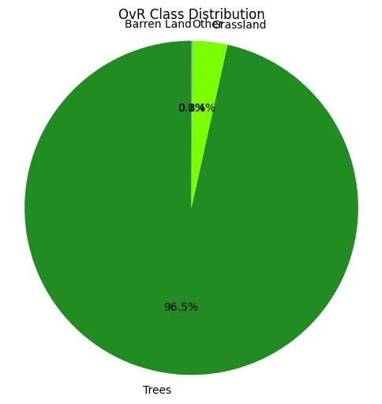
Total time for OvO predictions: 35.1832 seconds
Total time for OvR predictions: 1.6361 seconds
Avg time per OvO prediction: 0.0145 seconds
Avg time per OvR prediction: 0.0007 seconds

Slide 13
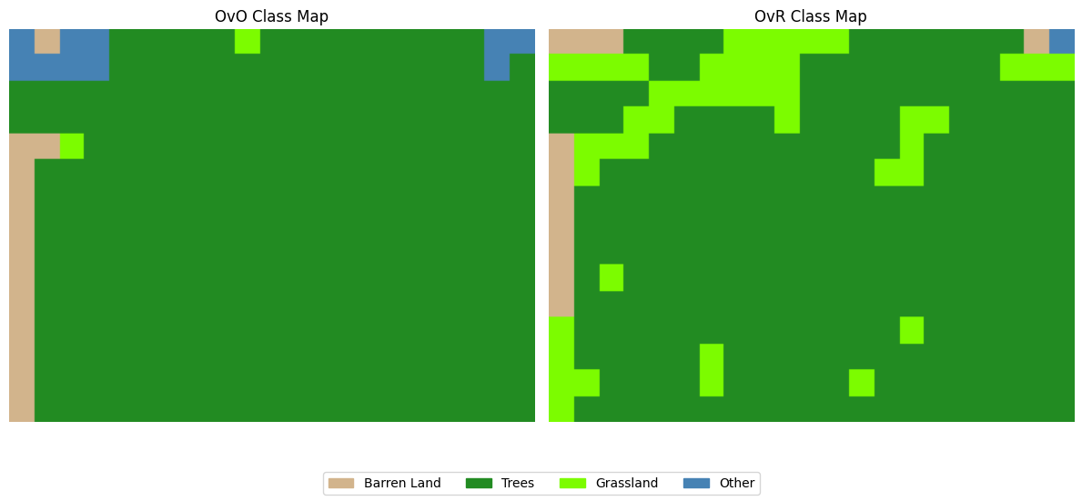
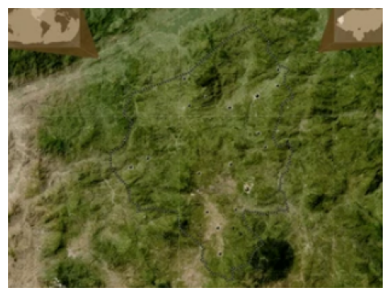
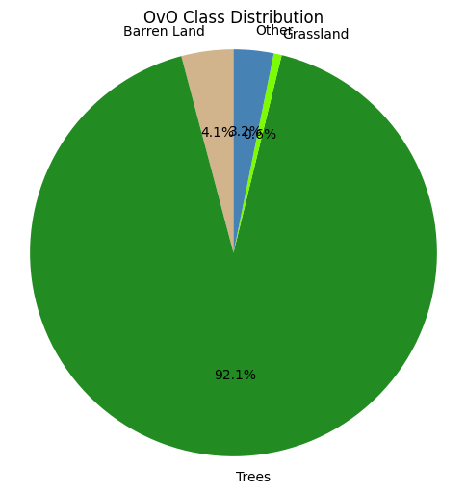
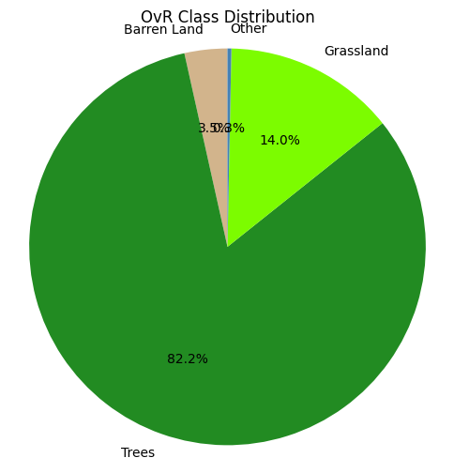
Total time for OvO predictions: 4.8023 seconds
Total time for OvR predictions: 0.2233 seconds
Avg time per OvO prediction: 0.0152 seconds
Avg time per OvR prediction: 0.0007 seconds

Slide 14
Conclusion
Class | OvO Performance | OvR Performance | Better Classifier
Trees | Good detection, but noisier edges in mixed areas | Smooth, consistent detection across dense vegetation | OvR
Barren Land | Generally accurate, occasional overclassification | More defined boundaries, stable predictions | OvR (slight edge)
Grassland | Finer details, but prone to fragmentation | Larger, smoother patches, but may lose detail | OvR (OvO good for detail)
Other | More misclassifications and inconsistency | More stable, but still least reliable class overall | OvR (more stable)
OvR is more accurate and visually stable across most land cover types.
OvO is better suited for tasks needing finer boundary detail, but at the cost of consistency.
OvO Takes far more time as compared to OvR due larger number of classifiers.

